Slide 1
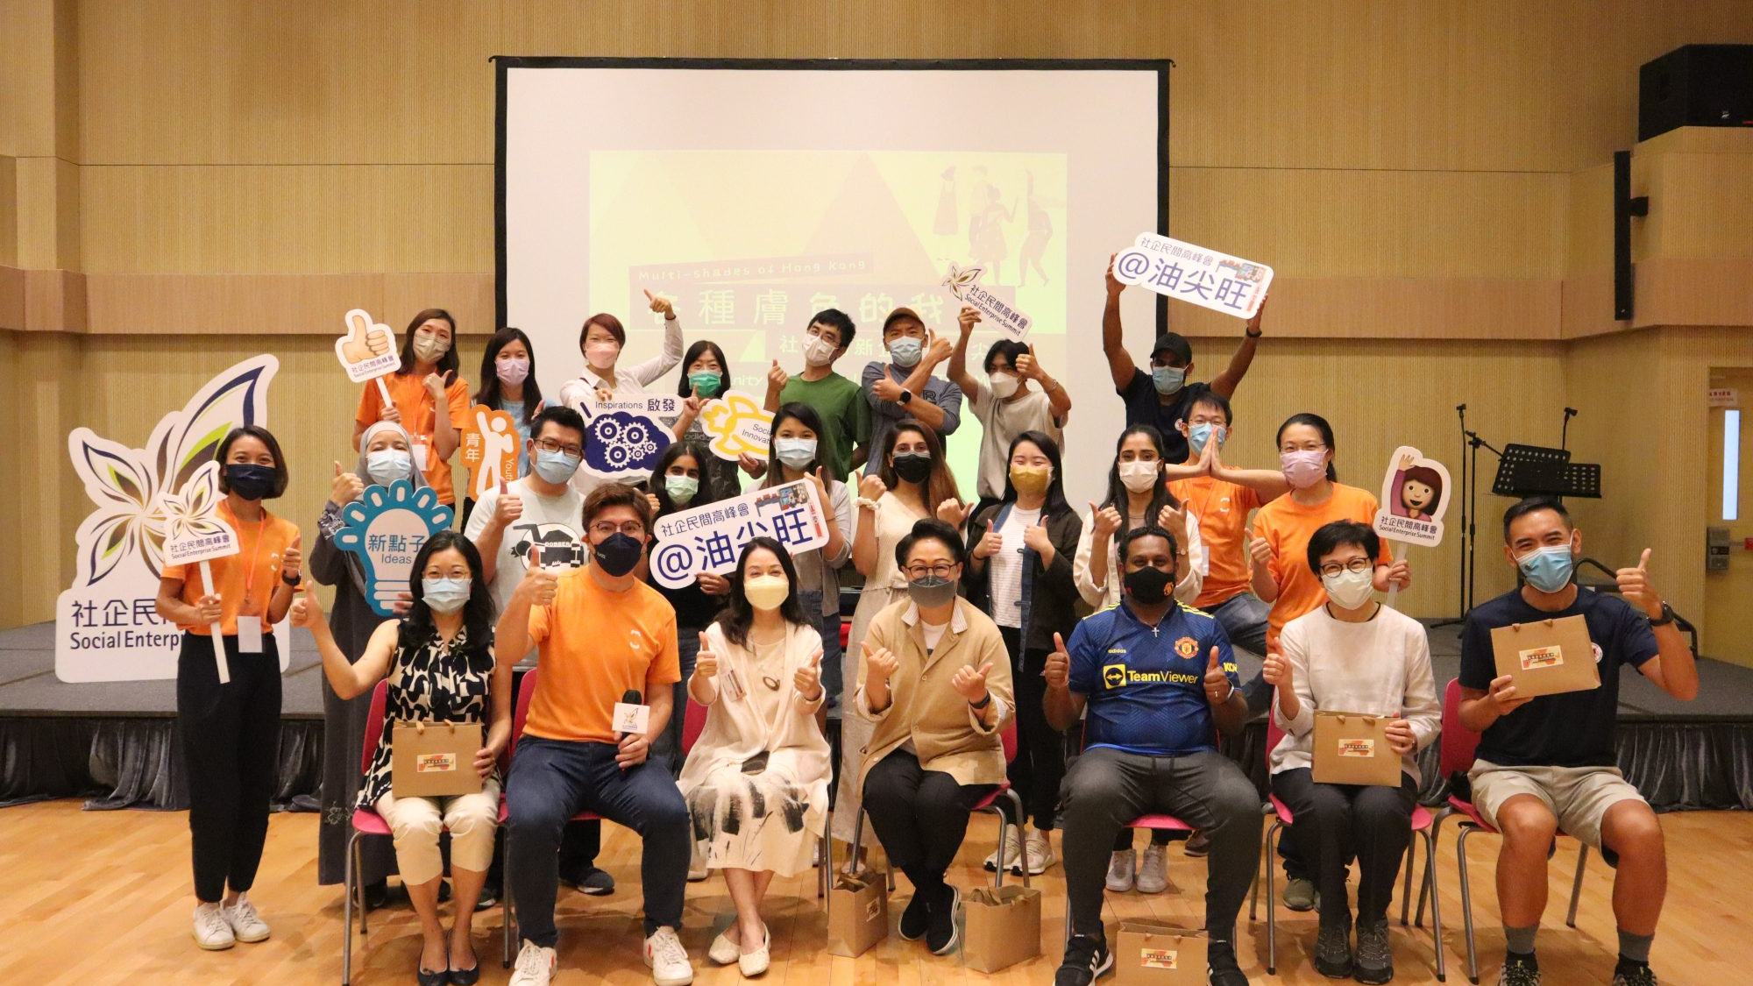
DIGITAL PLATFORM FOR CULTURAL HARMONY
KYK Foundation:
Bridging Communities,
Building Integration
A Digital Platform Promoting Hong Kong-Pakistani Cultural Harmony
Continuing the Spirit of
Kung Yung Koon
January 2026

Slide 2
PRESENTATION OVERVIEW
Our Journey
01
The Story Behind KYK Foundation
02
Understanding the Challenge
Continuing the legacy of Kung Yung Koon and our founder's personal journey from classroom to community
Barriers to HK-Pakistani integration and the real challenges faced by the community
Discover our origins
Explore the barriers
03
Our Digital Integration Platform
04
Impact & Community Growth
How the KYK website bridges communities through cultural exchange and empowerment
Creating lasting bonds and building a model for sustainable integration
See our approach
View our impact
05
Join Our Mission
Be part of the change toward a more inclusive Hong Kong

Slide 3
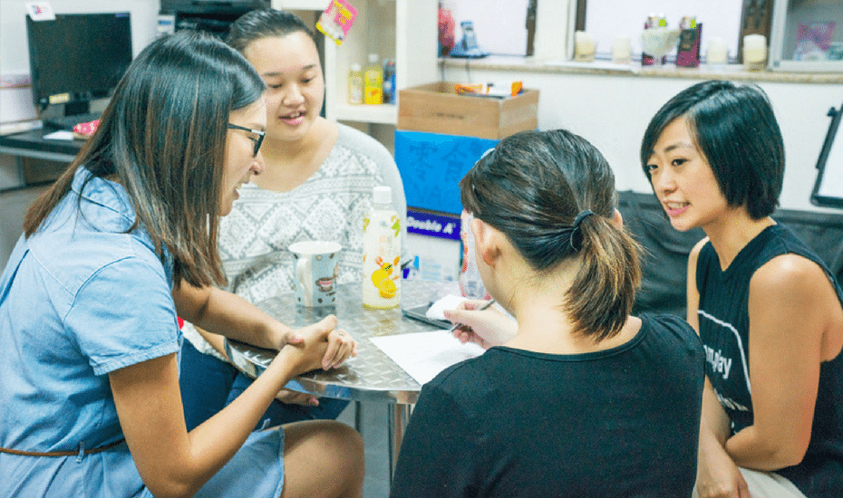
CHAPTER ONE
The Story Behind
KYK Foundation
Continuing the Legacy of Kung Yung Koon

Slide 4
OUR ORIGIN STORY
From Classroom to Community
Our Founder's Journey
The Founding Vision
2016: The Beginning
Assigned to teach Pakistani students newly arrived in Hong Kong at a secondary school, our founder discovered a profound cultural curiosity and genuine connection that would change everything.
"Through the programme, I was assigned to Pakistani families while gaining valuable working experience. Till now, I still keep in touch with some of them. Therefore, I established KYK Foundation to continue the missions of Kung Yung Koon."
Discovery Phase
Through conversations with both newly arrived and Hong Kong-born Pakistani students, a deep curiosity about Pakistani culture emerged, leading to active exploration and community engagement .
This authentic, lived experience drives our organization's purpose:
Personal connection to the community
Understanding real challenges
Volunteer Journey
Commitment to lasting impact
Digital continuation of physical work
Joined Kung Yung Koon's local tour and volunteered to teach Cantonese to Pakistani mothers and tutor students , creating sweet memories that last to this day.

Slide 5
OUR ROOTS
Kung Yung Koon: A Legacy of Cultural Harmony
What is Kung Yung Koon?
Core Activities & Impact
Kung Yung Koon (共融館), meaning "Harmony Hall" or "Inclusion Center"," is a community project operated by HKSKH Lady MacLehose Centre in Kwai Chung's Ping Lai Path.
1
Cultural Exhibitions
Showcasing South Asian immigration history, traditions, and cultural heritage
2
Guided Community Tours
Located in a vibrant South Asian neighborhood with Islamic restaurants, grocery stores, and mosques, it has served as a physical bridge between local Chinese and South Asian communities for years.
Leading visitors through the neighborhood to experience authentic South Asian culture
3
Cultural Workshops
Interactive sessions teaching Arabic greetings, Halal food culture, and traditions
4
Music & Arts Events
Location & Context
Celebrating diversity through performances and creative expression
Ping Lai Path, Kwai Chung - Home to a vibrant South Asian community since the 1970s industrial development
Community revitalization project - Part of "Our Community of Love & Mutuality" initiative
KYK Foundation's Digital Continuation
Multilingual environment - Blessings in different languages decorate public spaces
While Kung Yung Koon operates physically, KYK Foundation extends this mission digitally, reaching more families, providing 24/7 resources, and creating a scalable platform for community integration across Hong Kong.

Slide 6
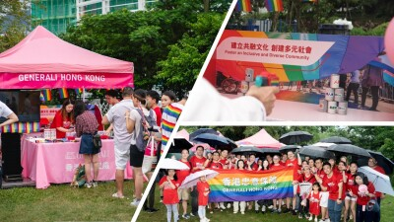
CHAPTER TWO
Understanding
the Challenge
Barriers to HK-Pakistani Integration

Slide 7
BY THE NUMBERS
The Pakistani Community in Hong Kong
Community Overview (2021 Census)
Historical Context
70s
Industrial Development - Rapid industrial growth in Kwai Chung attracted Pakistani migrants seeking employment
24,385
22.6%
30+
Pakistanis in HK
of South Asian population
Years many families lived here
80s
Community Formation - Families settled and established roots, creating tight-knit communities
The Pakistani community is one of Hong Kong's longest-established ethnic minority groups, with many families having lived here for generations since the British colonial era. They are not new arrivals but an integral part of Hong Kong's multicultural fabric .
Now
Third Generation - Many young Pakistanis are Hong Kong-born, native Cantonese speakers
Geographic Distribution
Pakistani communities are concentrated in districts with more affordable housing and historical employment opportunities:
Yuen Long
Yau-Tsim-Mong
Kwai Tsing
New Territories West
Kowloon Urban
Industrial Heritage
Key Insight
This is a well-established community seeking greater integration, not new arrivals. The challenges they face are systemic, not due to lack of time in Hong Kong.
Community Strengths
Strong family networks
Multilingual abilities
Entrepreneurial spirit
Cultural richness

Slide 8
THE CHALLENGES
Five Critical Barriers to Integration
Understanding what prevents full community participation
1. Language Barriers
4. Social Exclusion
Cantonese proficiency gaps severely limit educational and employment opportunities. The GCSE Chinese curriculum only covers Primary 3 level, insufficient for functional use.
Limited interaction between Chinese and Pakistani communities perpetuates stereotypes. Chinese parents often discourage children from playing with Pakistani children.
"Even if we can speak, read and write Chinese, our opportunities are still limited."
Research shows "weak ties" to external networks greatly disadvantage the community's ability to overcome underprivileged conditions.
2. Educational Segregation
5. Cultural Misunderstanding
40% of ethnic minority students attend schools where over 60% of students are from ethnic minority backgrounds, limiting Chinese language exposure.
Media stereotypes and skewed representations of Islam and Pakistanis exacerbate cultural misunderstandings. Lack of cross-cultural exposure breeds prejudice.
Designated schools often lack trained Chinese language teachers
Negative media portrayal affects social acceptance
3. Workplace Discrimination
The Root Cause
Higher unemployment rates persist even among qualified individuals. Pakistani professionals face barriers to promotion despite fluent Chinese and high qualifications.
While language and education are often cited, research reveals that systemic discrimination is the root cause—from educational segregation to workplace exclusion to social marginalization.
Pakistanis have the highest poverty rate among ethnic minorities
KYK Foundation addresses these barriers through direct community engagement and cultural bridge-building.

Slide 9
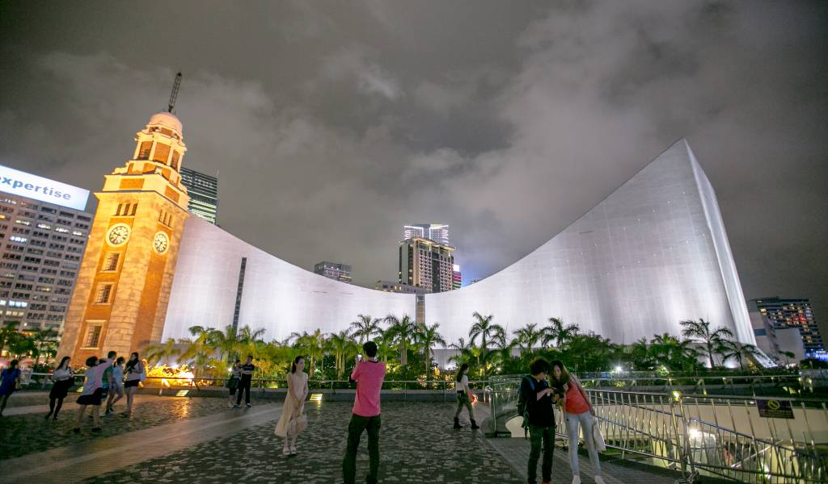
CHAPTER THREE
Our Digital
Integration Platform
How the KYK Website Bridges Communities

Slide 10
OUR APPROACH
Three Pillars of Digital Integration
How our website creates meaningful connections
Cultural Exchange Hub
Family Empowerment Portal
Community Growth Platform
Providing comprehensive information about Pakistani culture, history, and traditions to foster understanding and appreciation among the Chinese community.
Connecting Pakistani families with language learning resources, tutoring support, and community services to overcome barriers and achieve social mobility.
Facilitating volunteer opportunities, workshops, and events that bring Chinese and Pakistani communities together for meaningful interaction.
Cultural education resources
Cantonese learning programs
Volunteer matching system
Festival and celebration guides
Student tutoring connections
Workshop registration
Religious and dietary information
Employment support resources
Community event calendar
Immigration history stories
Community service navigation
Success story sharing
Digital-First Integration Model
∞
24/7 accessibility • Scalable reach • Resource permanence • Community building
Potential Impact

Slide 11
CORE PROGRAMS
Workshops: The Heart of Our Integration Strategy
Cantonese Language Programs
Cultural Sharing Sessions
Immersive language learning for Pakistani mothers and students, taught by Chinese volunteers in small group settings. Research shows social strategies are the most effective for Cantonese learning.
Interactive workshops where Chinese and Pakistani community members learn about each other's traditions, breaking down stereotypes through direct experience.
Small group classes
Volunteer tutors
Halal Food Culture
Understanding dietary practices and sharing traditional Pakistani cuisine
Family-focused
Regular sessions
Religious Traditions
Learning about Islamic practices, greetings, and cultural norms
Arts & Celebrations
Experiencing Pakistani music, dance, and festival celebrations
Why Social Learning Works
Research on ethnic minority students in Hong Kong found that social strategies are the most effective for learning Cantonese:
Volunteer Training
"Talking to locals helped me learn new words and get correction when I made mistakes"
Preparing Chinese volunteers to become effective cultural bridge-builders through sensitivity training and teaching methodology workshops.
"Made me more confident about my speaking ability"
"I learnt more from outside than I did from school"
Certified volunteer program

Slide 12
CHAPTER FOUR
Impact &
Community Growth
Building Stronger Connections

Slide 13
REAL IMPACT
Creating Lasting Bonds
The qualitative impact of KYK's community work
Ongoing Relationships
Breaking Stereotypes
Chinese volunteers build lasting friendships with Pakistani families they tutor, extending beyond organized activities into genuine community connections.
Direct interaction helps community members break down prejudices and see each other as individuals rather than stereotypes, fostering mutual respect.
"Till now, I still keep in touch with some of them." - Our Founder
Understanding cultural context reduces misunderstandings
Shared experiences create common ground
Personal connections override media narratives
Confidence Building
Building "Weak Ties"
Students gain confidence in Cantonese communication through supportive, non-judgmental practice environments that encourage risk-taking and growth.
Research by Granovetter (1973) shows that "weak ties" to external networks are essential for social mobility. KYK creates these crucial bridging connections.
Speaking confidence
Social comfort
Academic improvement
Future opportunities
The Pakistani community's strong internal ties are complemented by weak ties to Chinese networks through KYK, enabling access to opportunities and resources.

Slide 14
SCALABILITY
A Model for Sustainable Integration
How Digital Creates Sustainability
Digital + Physical Integration
24/7 Accessibility
Online Discovery → Offline Engagement
Unlike physical community centers with limited hours, the website provides constant access to resources and information, allowing families to engage at their convenience.
Website visitors learn about programs online, then attend in-person workshops
Scalable Reach
Digital platforms can serve more families than physical space allows, reaching across districts and expanding impact exponentially.
Virtual Learning → Real-World Practice
Online language resources support face-to-face tutoring sessions
Resource Permanence
Online resources, tutorials, and materials remain available indefinitely, creating a lasting knowledge base for continuous learning.
Digital Community → Physical Network
Online connections translate to real friendships and support systems
Pioneering Digital-First Community Integration
While many NGOs focus on physical programs, KYK Foundation pioneers a digital-first approach that complements and extends traditional community work, creating a replicable model for other communities in Hong Kong.
Future Expansion
This model can be replicated for other ethnic minority communities in Hong Kong, creating a network of digital integration platforms across the city.

Slide 15
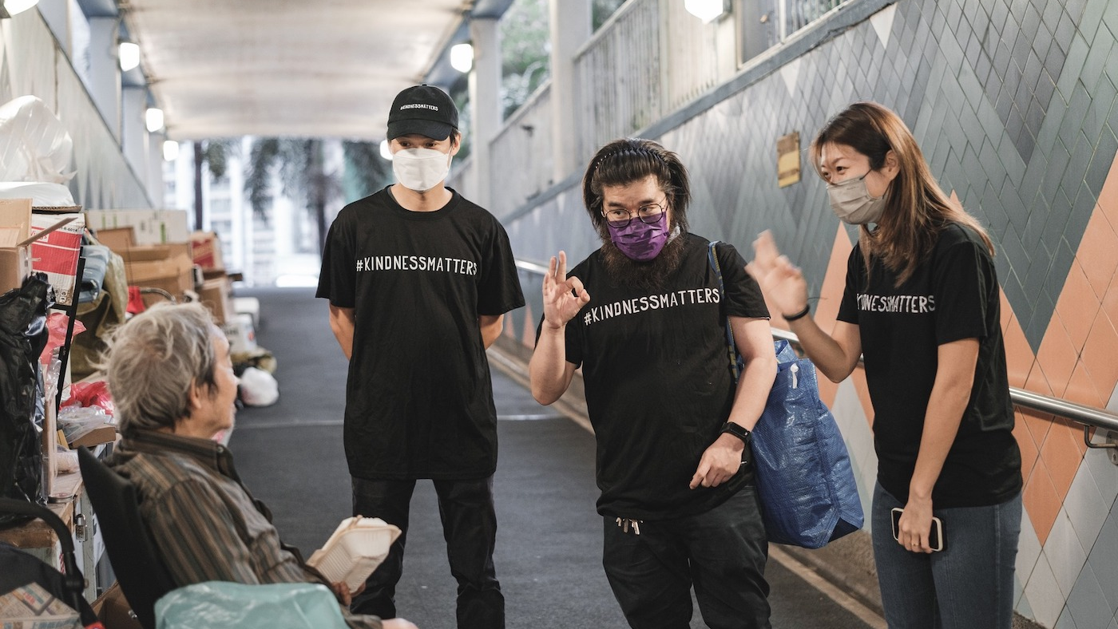
CHAPTER FIVE
Join
Our Mission
Be Part of the Change

Slide 16
GET INVOLVED
How You Can Make a Difference
Volunteer as a Tutor
Join Workshops
Support & Partner
Share your Cantonese skills and make a direct impact on Pakistani families' language learning journey. Training and support provided.
Participate in cultural exchange workshops to learn about Pakistani culture, share Chinese traditions, and build cross-cultural understanding.
Help us continue Kung Yung Koon's mission through donations, organizational partnerships, or spreading awareness about our work.
Flexible time commitment
Cultural learning experiences
Financial contributions
Training provided
Meet community members
Organizational partnerships
Meaningful relationships
Break down stereotypes
Share our mission
Perfect for: Students, professionals, retirees
Open to: All community members
Welcome: Corporates, NGOs, individuals
Every Contribution Matters
Join
Whether you volunteer an hour, attend a workshop, or share our story, you help continue Kung Yung Koon's inspiring journey of building a more inclusive Hong Kong.
Hands with Us

Slide 17
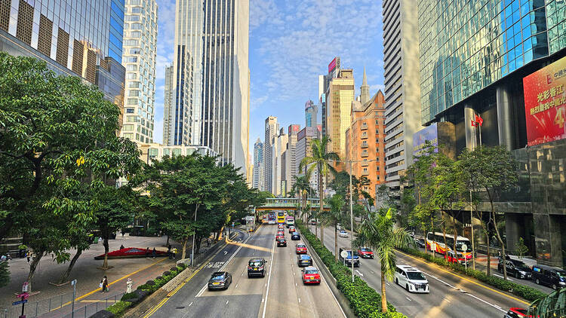
OUR VISION
Together, We Build a
More Inclusive Hong Kong
KYK Foundation continues the spirit of Kung Yung Koon, using digital innovation to bridge communities and create lasting cultural harmony.
Cultural Exchange
Empowering Families
Community Growth
Fostering understanding through shared experiences
Supporting Pakistani families to thrive in Hong Kong
Building bridges between Chinese and Pakistani communities
Visit Us
Contact
KYK Foundation
Get in Touch

